Slide 1
Sentiment Analysis of Text Data Fine-Tuning BERTweet on Sentiment140 Dataset
Team 7: Brian Leung, Cayden Calo, Carlos Munoz-Salazar

Slide 2
Problem
Sentiment Analysis:
Given a text -> Predict sentiment
Examples:
This movie was very good!
Predict: Positive
This movie was horrible.
Predict: Negative

Slide 3
Objective
Compare different fine-tuning methods
Full-tune – Upper Bound
LoRA (Low rank adaptation)
Prompt Tuning
Classifier Head Only – Lower Bound
Strengths, Weakness, Trade-offs

Slide 4
Live Demo!

Slide 5
Data + Preprocessing
Dataset – Sentiment140
Preprocessing
Removed unused columns: ID, Date, Flag, User
Filtered labels to {0, 4} and remapped to {0, 1}
Normalized text:
User mentions → @USER
URLs →HTTPURL
Encoding: ISO-8859-1 (Latin-1)
Data split:
90% training
5% validation
5% test

Slide 6
Set up + Hyperparameters
Model: vinai/bertweet-base
2-class classification head
Pre-trained on twitter data (slang, abbreviations, etc)
Training set up
Optimizer: AdamW
Batch size: 16 (Effective batch size = 32)
Gradient accumulation: 2
Epochs: 3
Evaluation: per epoch
Model selection: best validation F1
Mixed precision: fp16 enabled

Slide 7


Hyperparameters Cont.
Full Fine-Tuning (Upper bound)
Classifier Head Only (Lower bound)
All model parameters are trainable
Learning rate: $2e−5$
Warmup ratio: 0.06
Weight decay: 0.01
Backbone is frozen
Only classification head is trained
Same hyperparameters as full fine-tuning

Slide 8

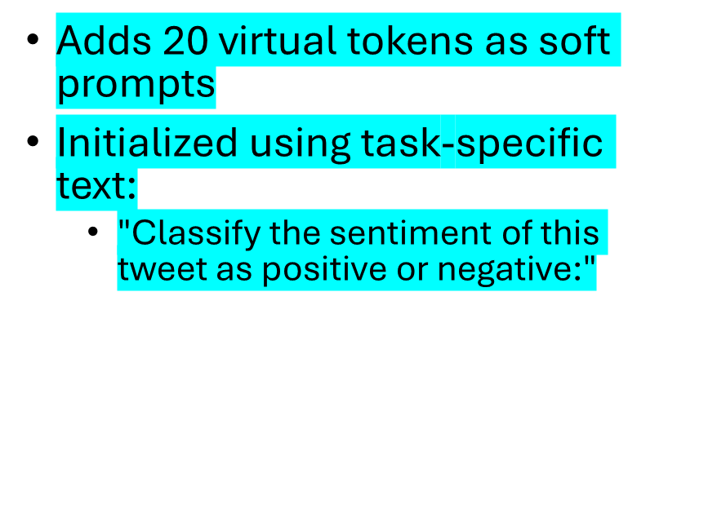
Hyperparameters Cont.
LoRA (Low-Rank Adaptation)
Prompt Tuning
Injected into attention layers (query, value)
Rank $r=$ 4, 8, 32
LoRA trained on various rank values
$α=32$, dropout = 0.1
Backbone weights frozen
Learning rate: $2e−4$
Adds 20 virtual tokens as soft prompts
Initialized using task-specific text:
"Classify the sentiment of this tweet as positive or negative:"
Backbone frozen
Classification head also unfrozen
Learning rate: $5e−4$

Slide 9
Results

Slide 10


Slide 11

Training Times using Google Colab T4 GPU

Slide 13
Insights Gained
Full fine-tuning achieves the best results but requires the most training time
LoRA achieves near-identical performance with ~22% less training time
Prompt tuning is faster but sacrifices accuracy
Head-only training is fastest but significantly underperforms

Slide 14
Future Work
Extend to multi-class sentiment (include neutral)
Explore larger or alternative Transformer models

